Slide 1
BMCS 2113 Presentation
Predict likelihood of client subscribing to term deposit via telemarketing

Slide 2
Problem Statement
Term Deposit
Telephonic marketing
to determine and classify the clients who are most likely to subscribe or convert funds to a term deposit from the existing client base

Slide 3
Methodology
Data Pre-processing
Logistic Regression Models
K-Nearest Neighbour
Decision Trees
Random Forest
Support Vector Machine (SVM)
Multinomial Naive Bayes

Slide 4
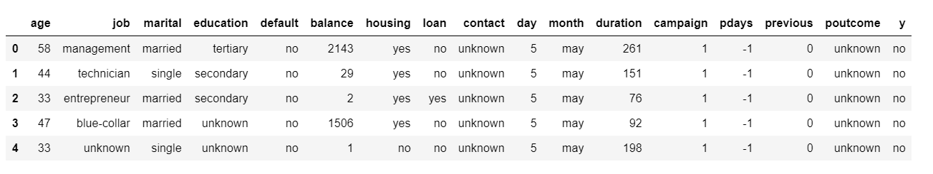
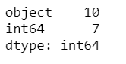
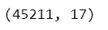
Data Pre-processing
How many rows and columns

Slide 5
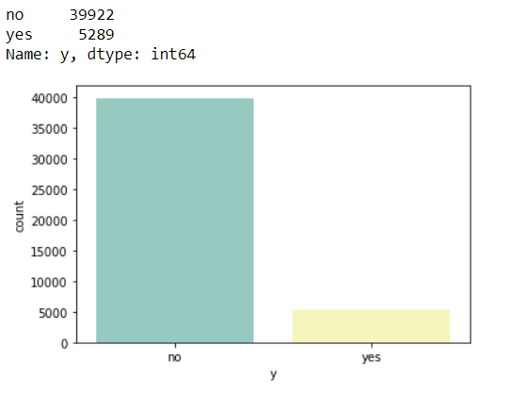
Check whether it is a balanced data or unbalanced data

Slide 6
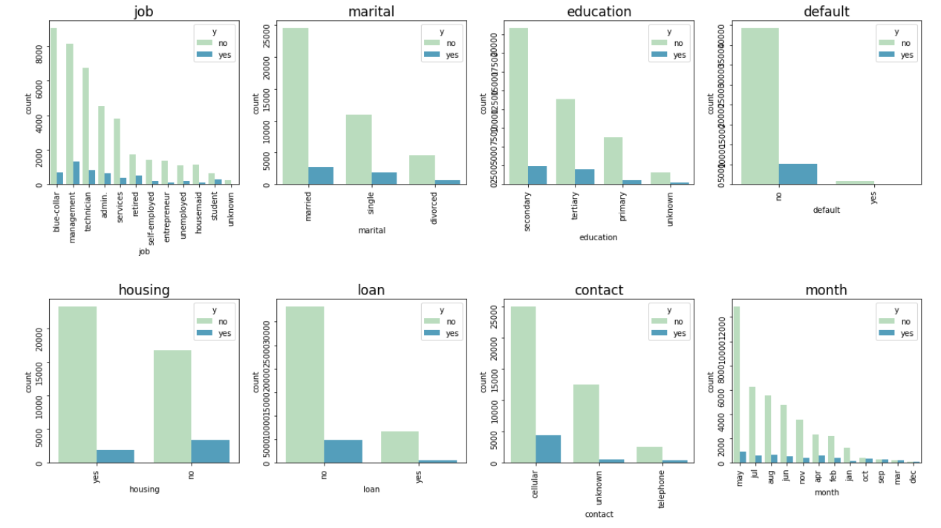
To observe the result for each categorical feature

Slide 7
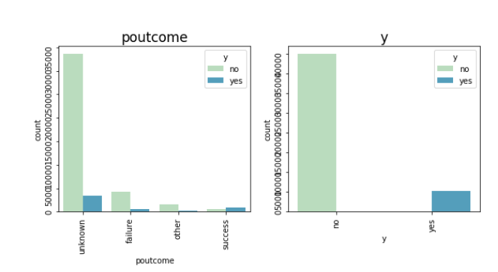

Slide 8
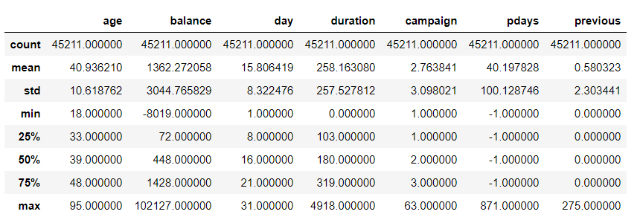
Numerical feature to check for distribution
To check for the min and max value, apply scaling method if necessary
The min value of balance is a negative value
The min value of previous and duration are 0

Slide 9
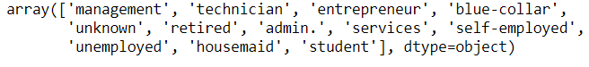
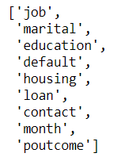
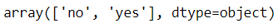
To observe the unique value for each categorical features

Slide 10
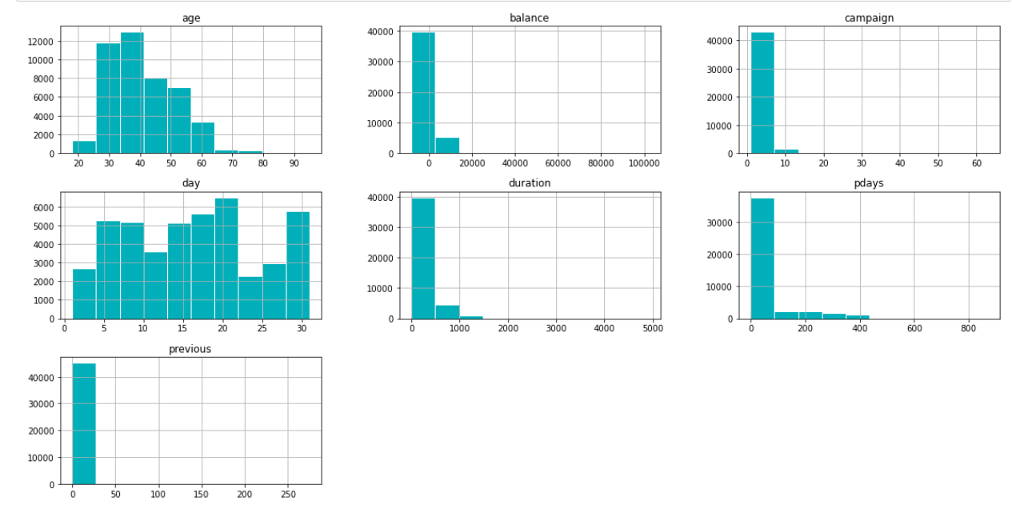

Slide 11
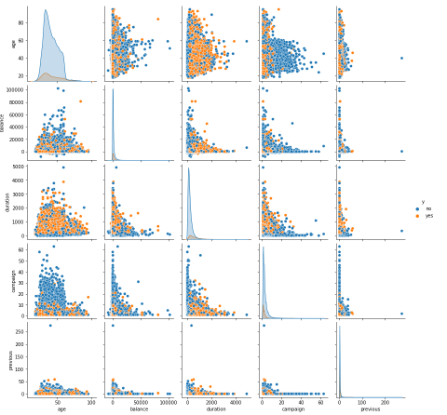

Slide 12
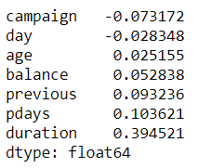
Correlation between features and label
All the numerical features are not so correlated with the label.

Slide 13
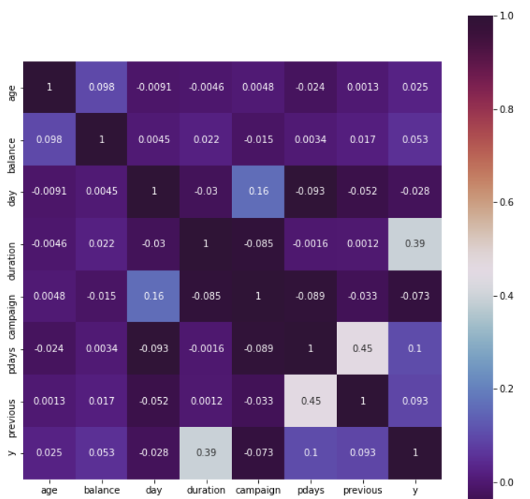
Correlation among the features

Slide 14
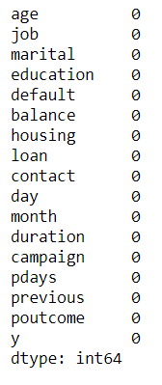
Checking for missing values in the data set
There are no missing values in the data.

Slide 15
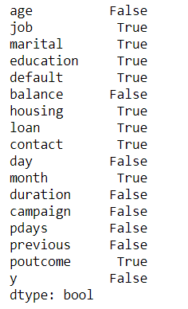
Abstract the column name that consist of categorical variable
Abstract the column name directly -> will get all the column that has string variable
In this case, we no need to write all the column. This function will directly get all the column name that has string variable
Because we need to do One Hot encoding for all the variable (Use this so that we can directly use the name to do One Hot encoding)

Slide 16
Feature Scaling
Involved Normalization and Standardization
Minmax Scaler (Normalization)
MinMaxScaler scales all the data features in the range [0, 1] or else in the range [-1, 1] if there are negative values in the dataset
Standard Scaler (Standardization)
StandardScaler follows Standard Normal Distribution (SND). Therefore, it makes mean = 0 and scales the data to unit variance.’

Slide 17
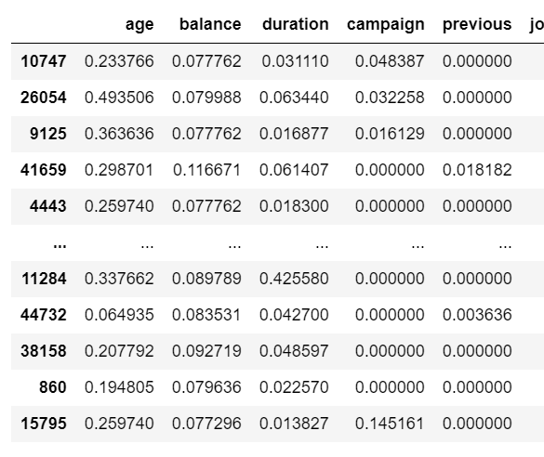
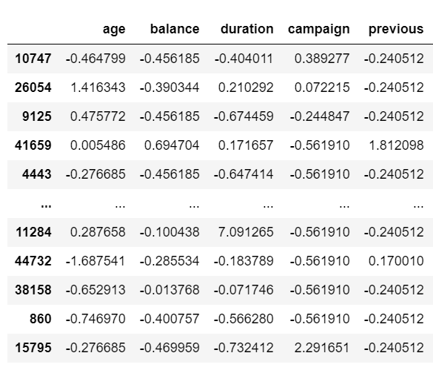
Only scale for the numerical feature
Fit and transform the X_train then transform the X_test
Minmax Scaler
Standard Scaler

Slide 18
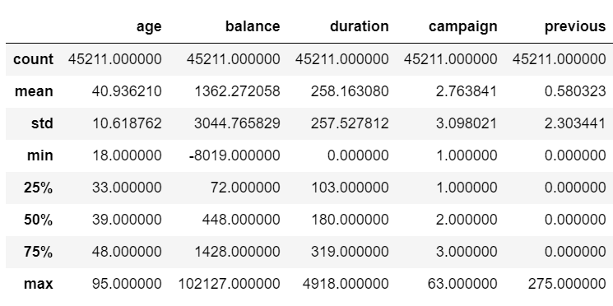
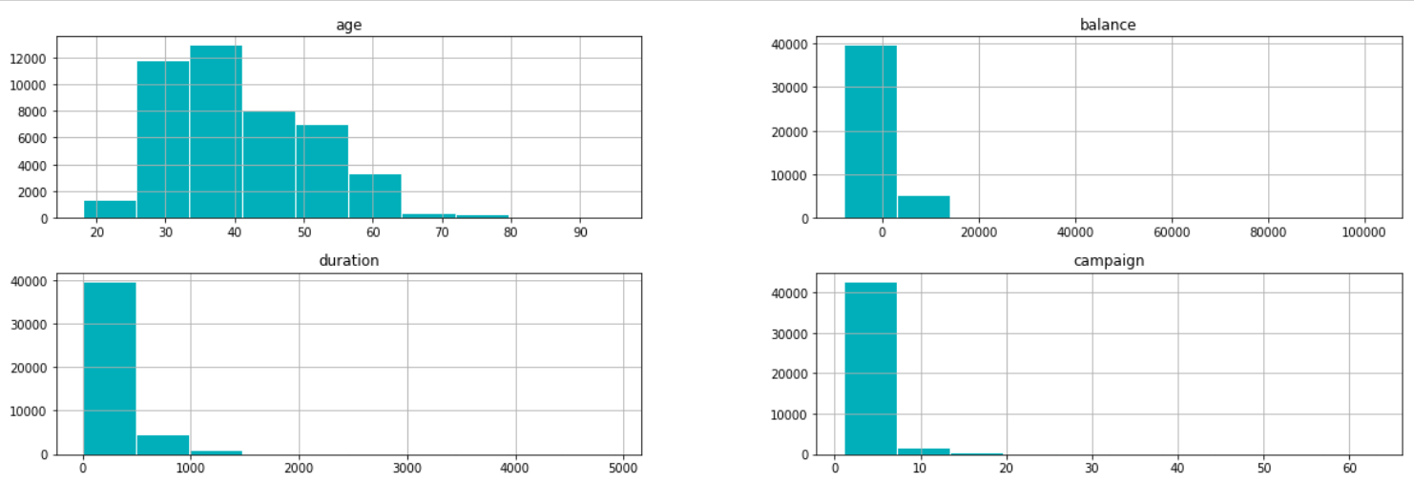
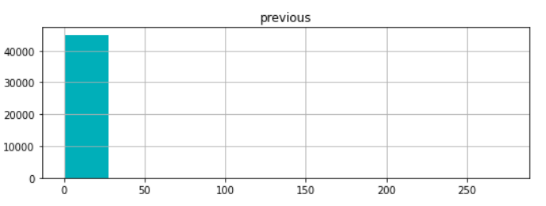
Log Transformation
The log transformation can be used to make highly skewed distributions less skewed.
This can be valuable both for making patterns in the data more interpretable and for helping to meet the assumptions of inferential statistics.
As the graph shown above it shows that only the age feature is normally distributed and others are right skewed graph.
In our program, there exist negative value and zero value in the particular feature.
To move the others feature to more normal distributed, we apply log transformation but there exist the negative value and zero value in some feature.
So, to handling negative values and zero values, add a constant value to the data prior to applying the log transform.

Slide 19
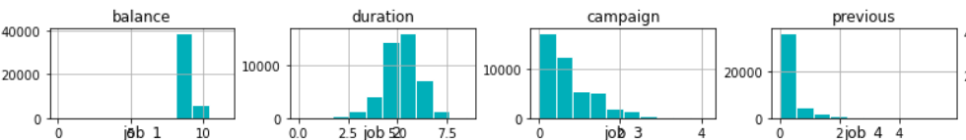
Graph below shows that the distribution of the feature has improve to the normal:

Slide 20
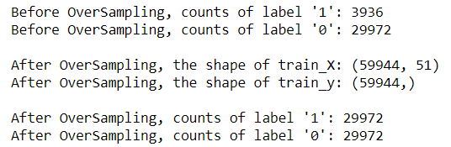
Over-sampling using SMOTE since the data is unbalanced
Now we have a perfect balanced data!

Slide 21
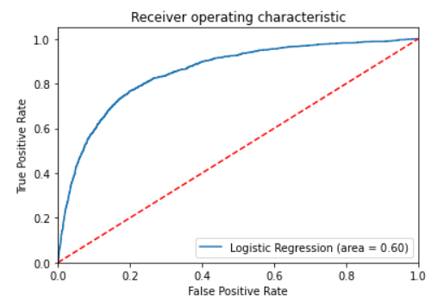
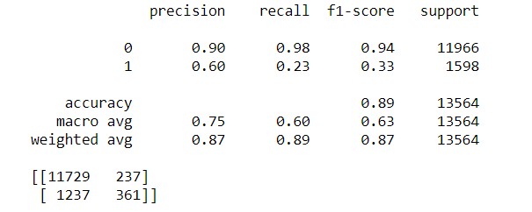
Logistic Regression
Non-scaled data

Slide 22
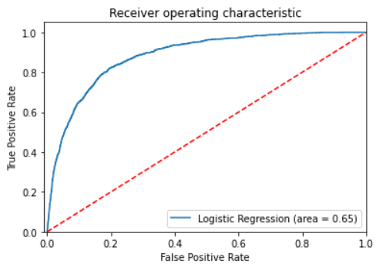
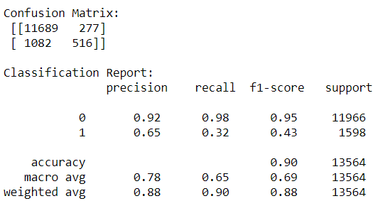
Minmax Scaled Data

Slide 23
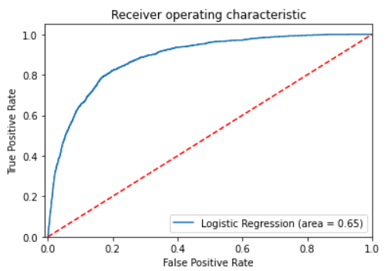
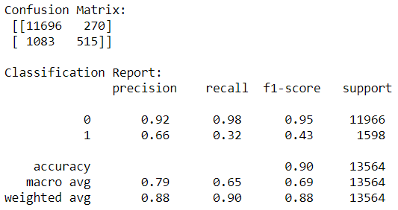
Standard Scaled Data

Slide 24
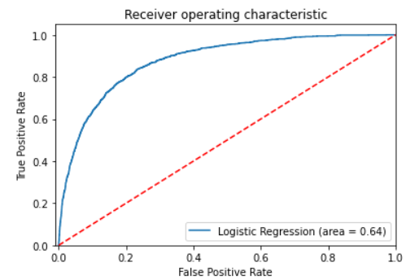
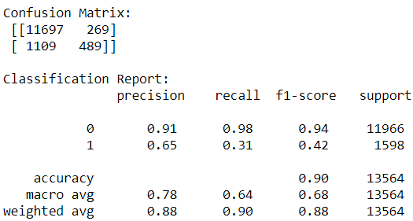
Log Transformed Data

Slide 25
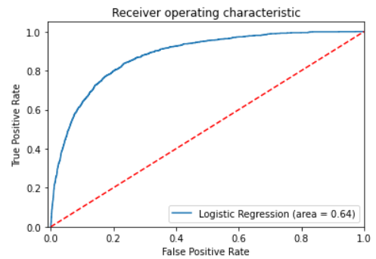
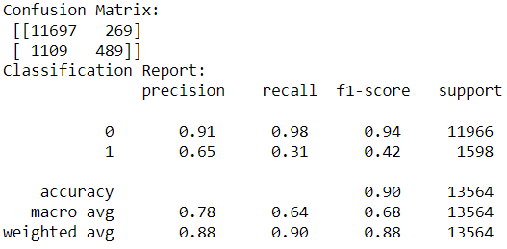
Minmax Scaled Data + Log Transformation

Slide 26
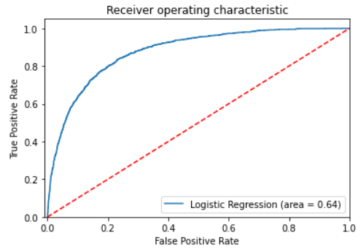
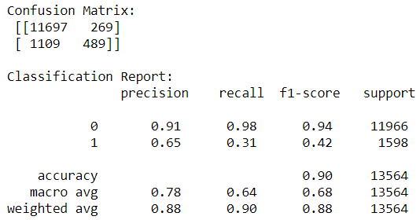
Standard scaled data + Log Transformation

Slide 27
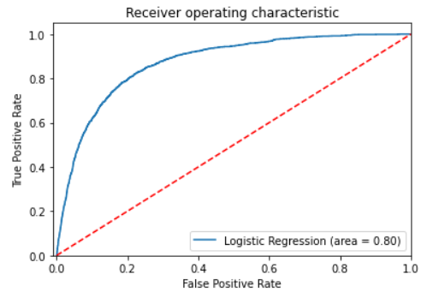
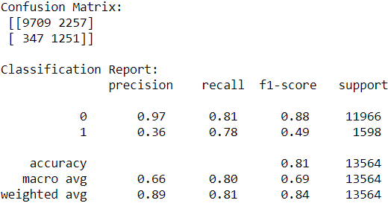
Non scaled data + SMOTE

Slide 28
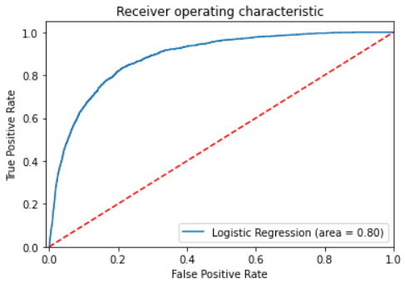
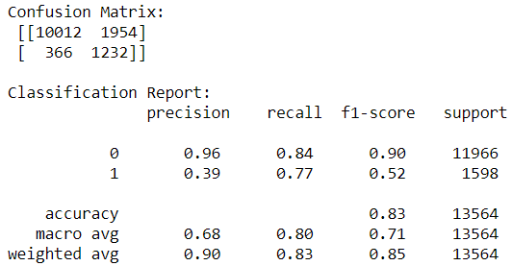
Minmax scaled data + SMOTE

Slide 29
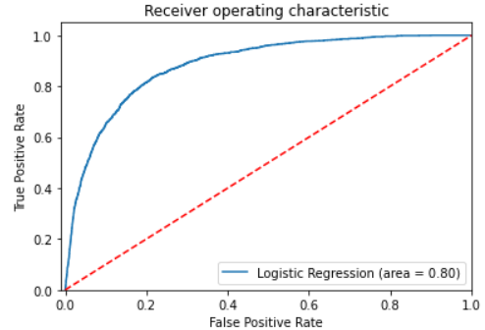
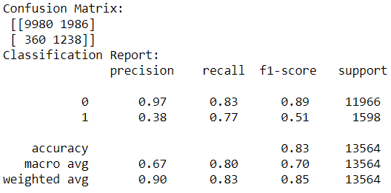
Standard scaled data + SMOTE

Slide 30
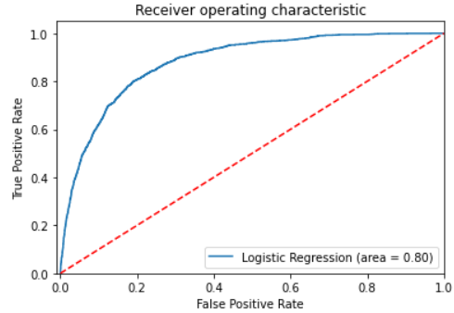
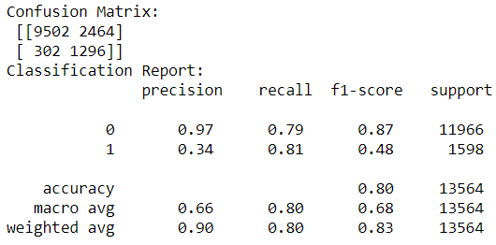
Non-scaled data + log transformation+ SMOTE

Slide 31
Minmax Scaled Data

Slide 32
Standard Scaled Data

Slide 33
Log Transformed Data

Slide 34
Minmax Scaled Data + Log Transformation

Slide 35
Standard scaled data + Log Transformation

Slide 36
Non scaled data + SMOTE

Slide 37
Minmax scaled data + SMOTE

Slide 38
Standard scaled data + SMOTE

Slide 39
Non-scaled data + log transformation+ SMOTE

Slide 40
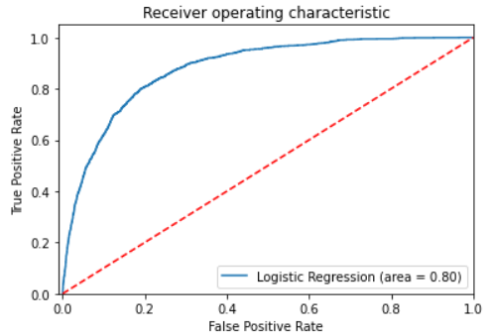
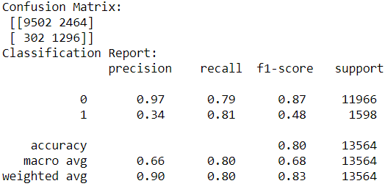
Minmax Scaler data + log transformation + SMOTE

Slide 41
Minmax Scaler data + log transformation + SMOTE

Slide 42
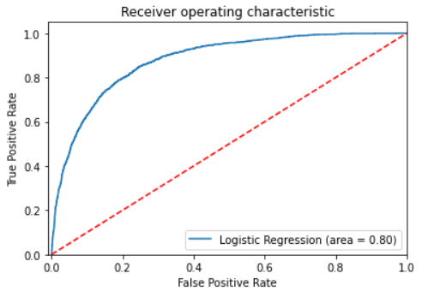
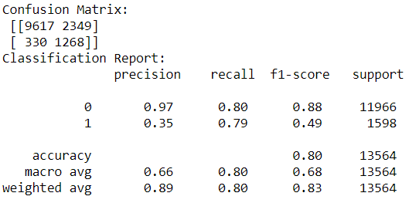
Standard scaled data + Log Transformation + SMOTE

Slide 43
Conclusion
The higher the AUC, the better the model is at predicting 0 and 1.
The higher the AUC, the better the model is at distinguishing between clients subscribing to a term deposit or not subscribing to a term deposit.
The highest AUC is 0.80 which are the Non-scaled Data + SMOTE, Minmax scaled Data + SMOTE, Standard scaled Data + SMOTE, Non-scaled Data + Log Transformation + SMOTE, Minmax scaled Data + Log Transformation + SMOTE and Standard scaled Data + Log Transformation + SMOTE.
This prove that data after oversampling with SMOTE gives a very good performance.

Slide 44
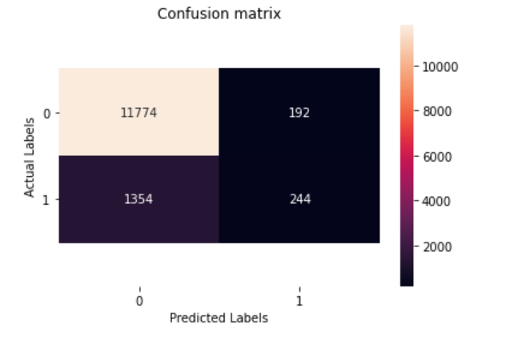
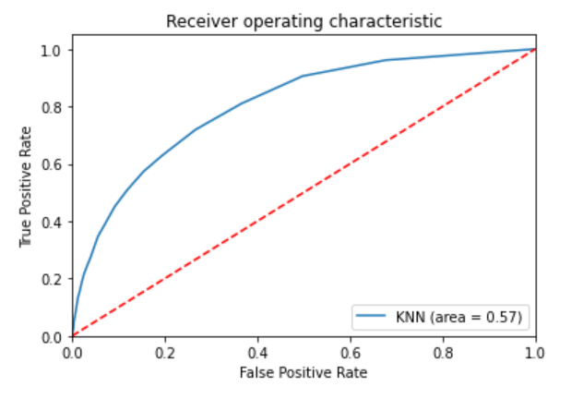
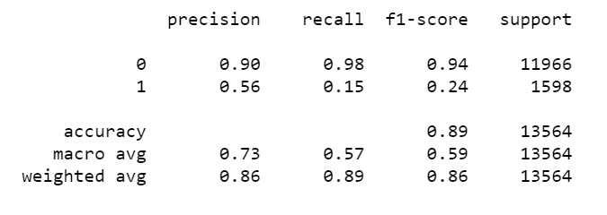
K-Nearest Neighbour
Non-scaled data

Slide 45



Using Min Max Scaler

Slide 46



Standard scale

Slide 47


SMOTE
Non scaled data

Slide 48


Minmax Scaler

Slide 49


Standard Scaler

Slide 50


Non scaled data + Log Transformation

Slide 51


Minmax Scaler + Log Transformation

Slide 52


Standard Scaler + Log Transformation

Slide 53


Non scaled data + SMOTE + Log Transformation

Slide 54


Minmax Scaler + SMOTE + Log Transformation

Slide 55


Standard Scaler + SMOTE + Log Transformation

Slide 56
Conclusion
Among all the different pattern of data, we conclude that the data that applied standard scaling, oversampling gave the larger ROC curve area which is 0.69. From the overall the non scaled data without any feature engineering give the smallest curve area, and then follow by the two type of data that go through feature scaling and log transformation (Minmax scaling data with log and standard scaling data with log) which get 0.59 for both data.
From the overall result in the confusion matrix, the f1 score that are more suitable to use for evaluation compare to accuracy shows a quite low value for every different pattern of data in building the knn model. A low F1 score is an indication of both poor precision and poor recall. The highest f1 score is 0.41 belongs to the model that applied Standard scaling and SMOTE.

Slide 57


Decision Tree
Non scaled Data

Slide 58


Non scaled data + SMOTE

Slide 59


Non scaled data + Log Transformation

Slide 60


Non scaled Data + SMOTE + Log Transformation

Slide 61
Conclusion
From the overall ROC- AUC value, there are almost same value which the different between each of them is only 0.01. The optimal decision tree model is the model that used a balanced data with log transformation which is 0.68. The worst model is the model that used imbalanced data without any any feature engireering. This indicate that it is better using a balanced data to obtain a stronger model.
​

Slide 62


Random Forest
Non Scaled Data

Slide 63


Non scaled data + SMOTE

Slide 64

Non scaled data + Log Transformation

Slide 65


Non scaled Data + SMOTE + Log Transformation

Slide 66
Conclusion
From the result of AUC value, we conclude that the data which had been oversampling and applied the log transformation give able to build a best performance of the random forest model compared to the others 3 data. It give a value of 0.80 that has a larger gap value between others 3 type of random forest model. Besides, the highest f1-score is 0.53 which is obtained from the model with the balance data with log transformation.

Slide 67

Support Vector Machine (SVM)
By Using Linear Kernel in SVM, the accuracy score obtained is 12.2%, which is considered really low. The dataset used is imbalanced and in high dimension, hence we need to tune hyperparameters to improve the accuracy in prediction by using GridSearch.

Slide 68
GridSearch CV
By using GridSearch, we find the best parameters and the most optimal kernel to be used in training the SVM model with normal training non scaled data.

Slide 69


Minmax Scaled Data
After fitting the min max scaled data, the optimal hyperparameters found are as below:
After fitting the min max scaled data, the best score of 88% is obtained:

Slide 70



Minmax Scaled Data

Slide 71


Standard Scaled Data
After fitting the standard scaled data, the optimal hyperparameters found are as below:

Slide 72



Standard Scaled Data

Slide 73


Non Scaled SMOTE Data

Slide 74



Non Scaled SMOTE Data

Slide 75


Minmax Scaled Data + SMOTE

Slide 76



Minmax Scaled Data + SMOTE

Slide 77


Standard scaled data + SMOTE

Slide 78



Standard scaled data + SMOTE

Slide 79


Non scaled data + Log Transformation

Slide 80



Non scaled data + Log Transformation

Slide 81


Minmax scaled data + Log Transformation

Slide 82



Minmax scaled data + Log Transformation

Slide 83


Standard scaled data + Log Transformation

Slide 84



Standard scaled data + Log Transformation

Slide 85


Non-scaled data + log transformation + SMOTE

Slide 86



Non-scaled data + log transformation + SMOTE

Slide 87


Minmax Scaler data + log transformation + SMOTE

Slide 88



Minmax Scaler data + log transformation + SMOTE

Slide 89


Standard scaled data + Log Transformation + SMOTE

Slide 90



Standard scaled data + Log Transformation + SMOTE

Slide 91
Conclusion
From the result of AUC value, we can conclude that the standard scaled data gives the best performance in the SVM rbf kernel with C value = 1 and gamma = 1
It gives a accuracy score of 87.7% which is considered relatively high.
However, SVM is not suitable to be used in this prediction model as the models give relatively low precision score, recall score and F1 score as the dataset used is imbalanced and in high dimension.
This explains that there is uneven class distribution and high false prediction accuracies.
Hence, SVM model is not suitable for the prediction model used in the proposed project.

Slide 92


Multinomial Naive Bayes
Non Scaled Data

Slide 93


MIn Max Scaler for Non Scaled Data

Slide 94


Oversampling the Non Scaled Data

Slide 95


Min Max Scaler for Oversampled Data

Slide 96


Transformed Data

Slide 97


Min Max Scaler for Transformed Data

Slide 98


Oversampled Transformed Data

Slide 99


MinMax Scaler for Oversampled Transformed Data

Slide 100

Concluding Best Model - Logistic Regression

